Slide 1
Lab 2 DD2421
Mervan Kaya

Slide 2
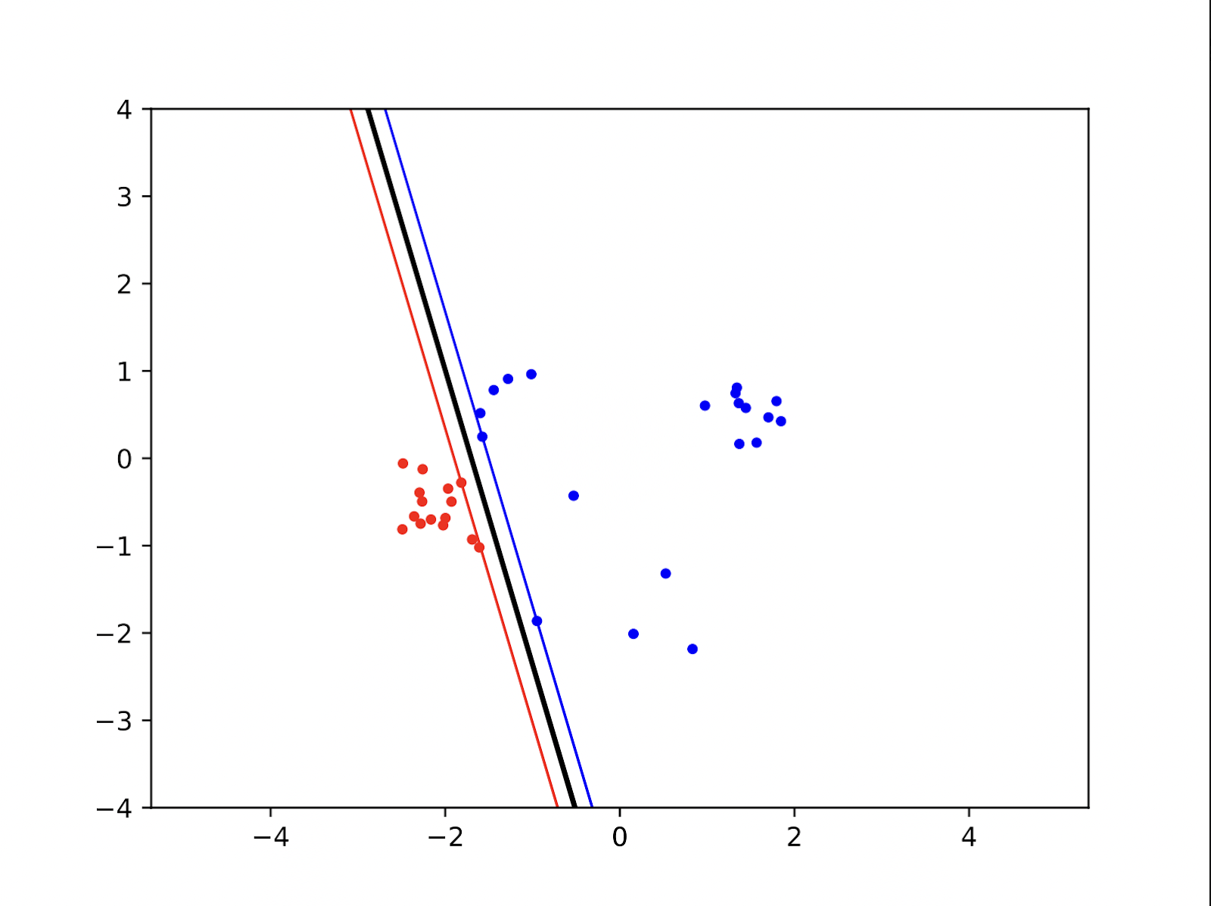
Linear Kernel

Slide 3
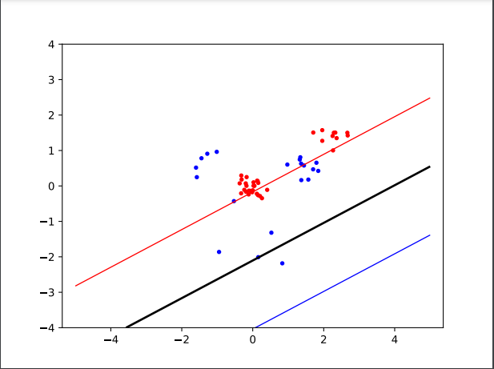
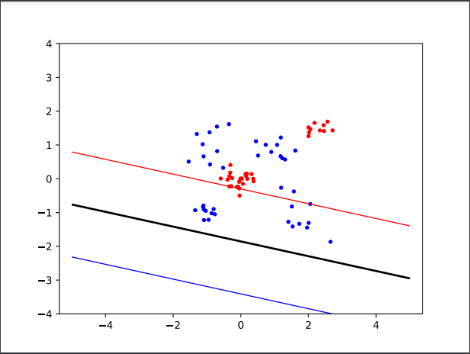
1. Different Sized Clusters

Slide 4
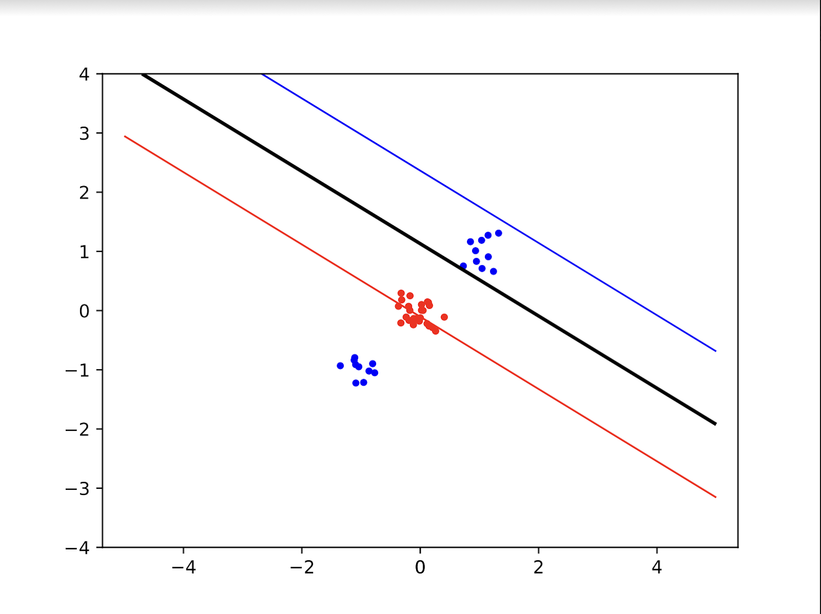
1. Different Sized Clusters

Slide 5
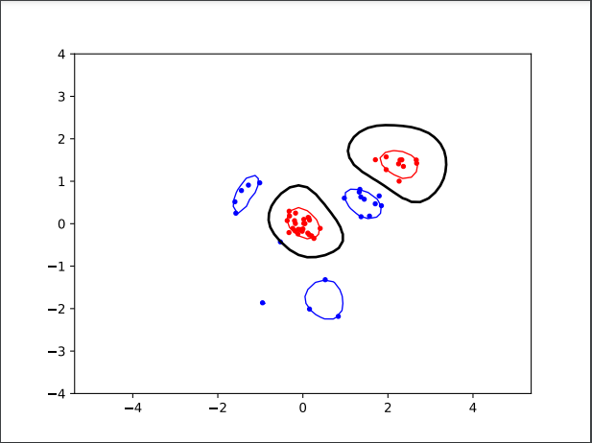
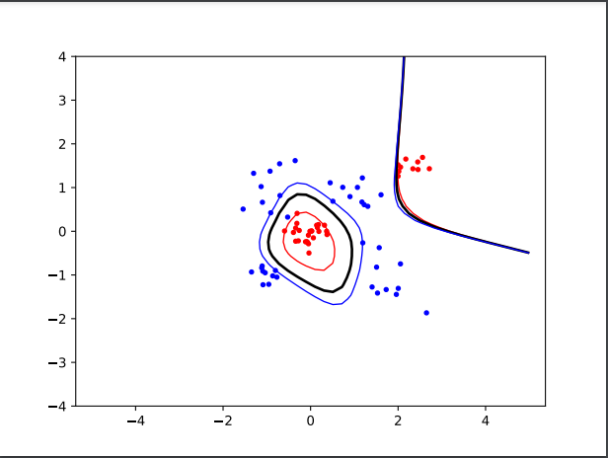
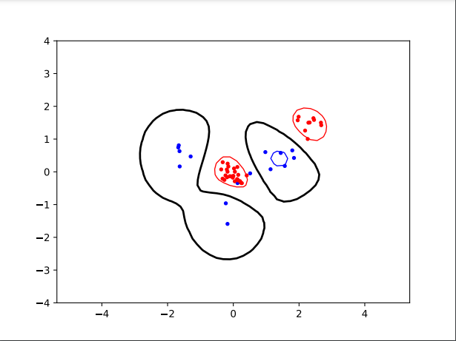
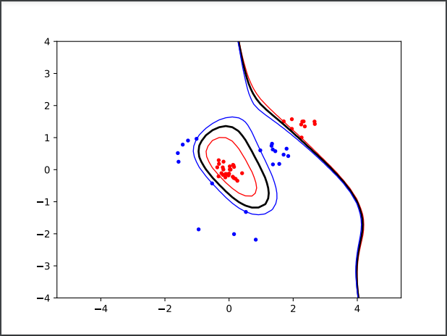
2. Non-linear Kernels and Different Sized Clusters
Polynomial with degree = 5
RBF with sigma = 0.5

Slide 6
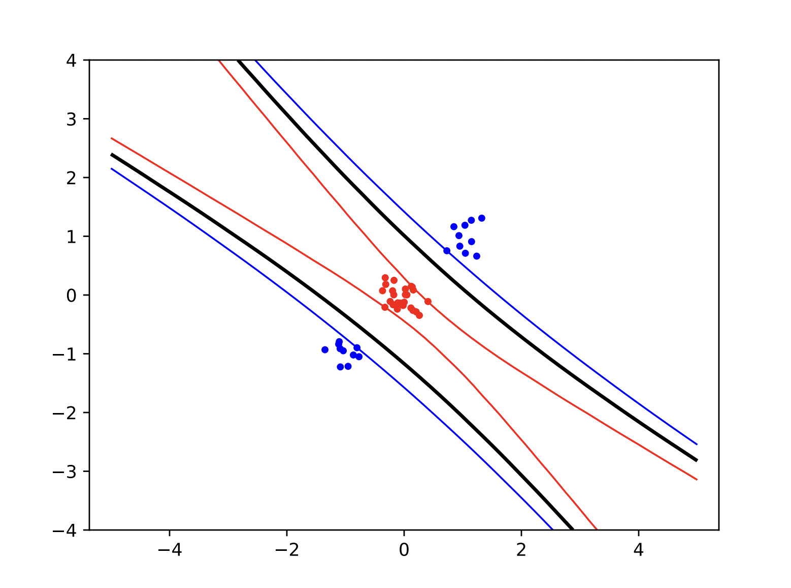
2. Non-linear Kernels and Different Sized Clusters

Slide 7
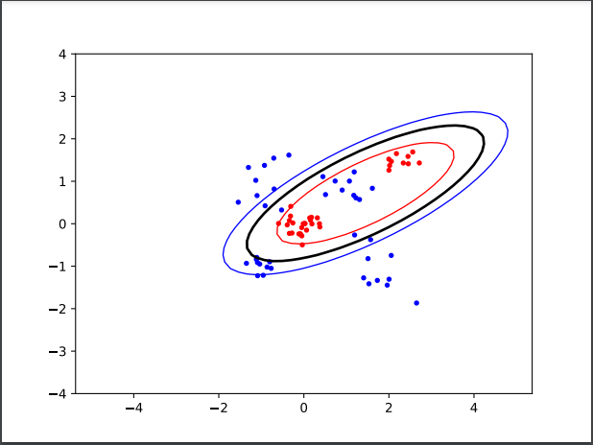
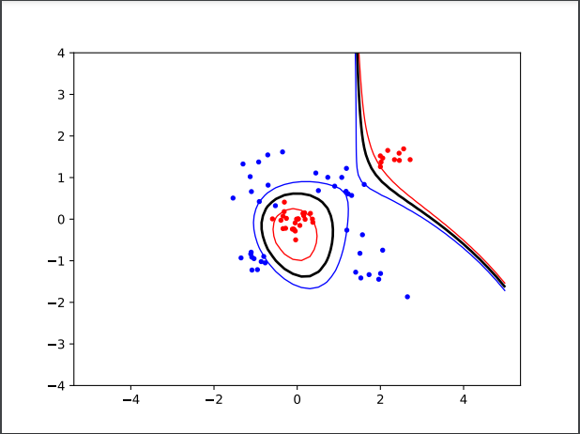
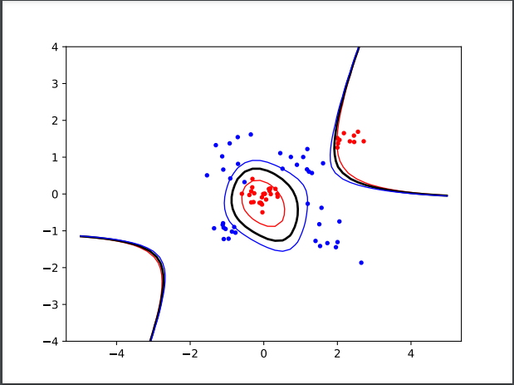
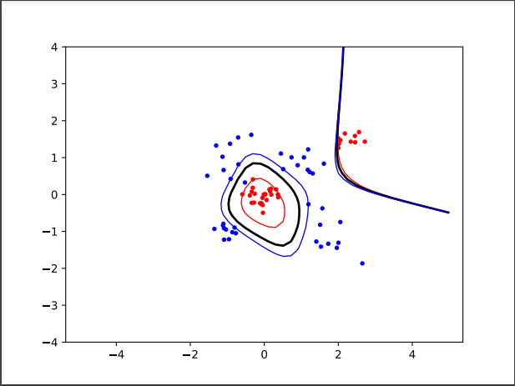
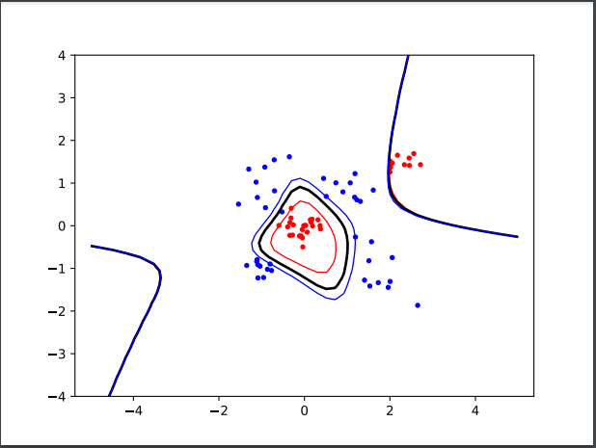
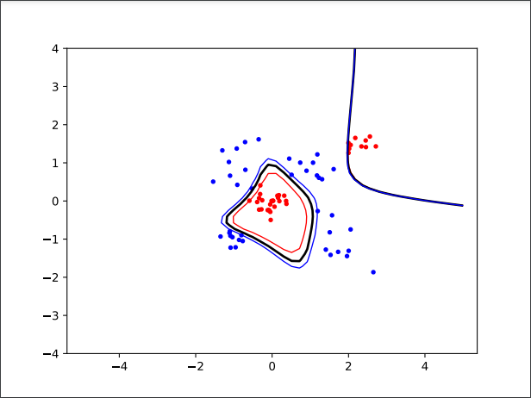
3. Effect of non-linear kernel parameters in terms of bias-variance trade-off – Polynomial Degree

Slide 8
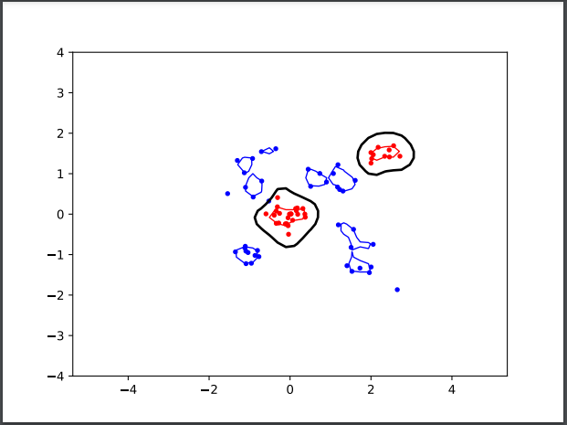
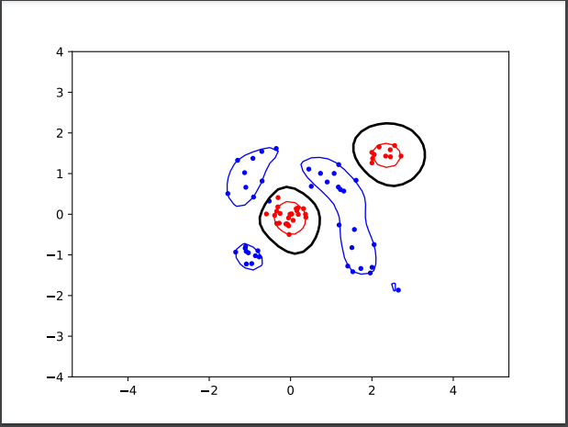
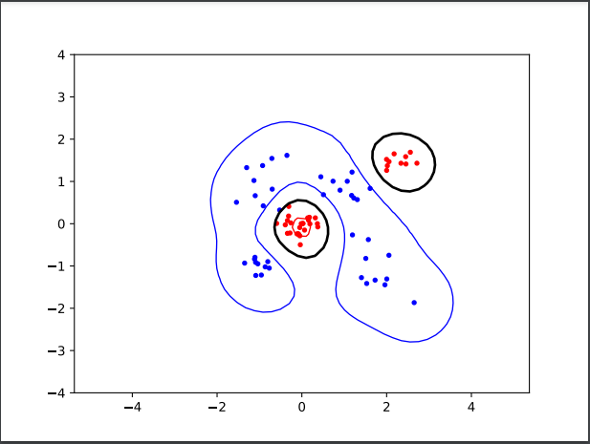
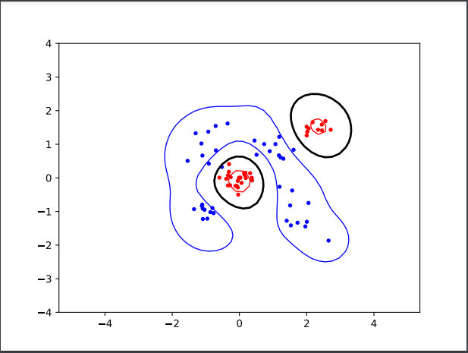
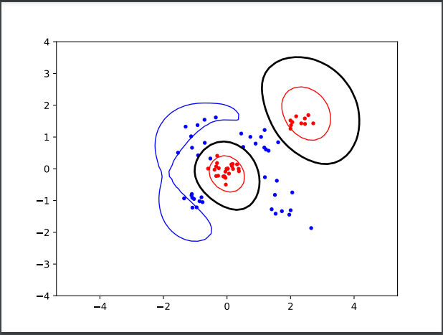
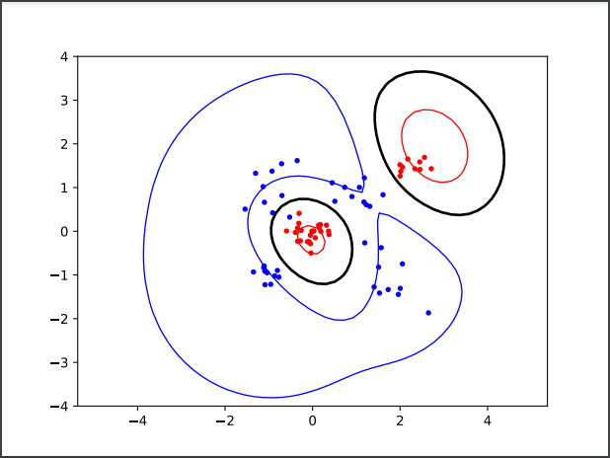
4. Effect of non-linear kernel parameters in terms of bias-variance trade-off – RBF Smoothness

Slide 9
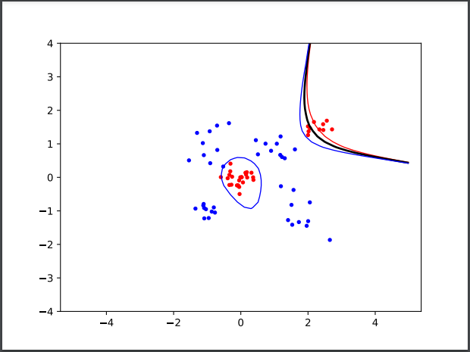
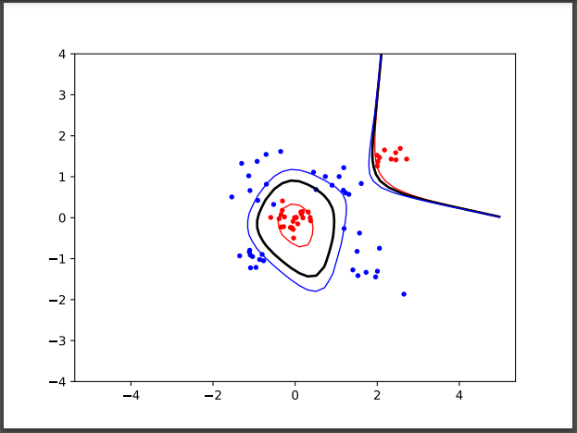
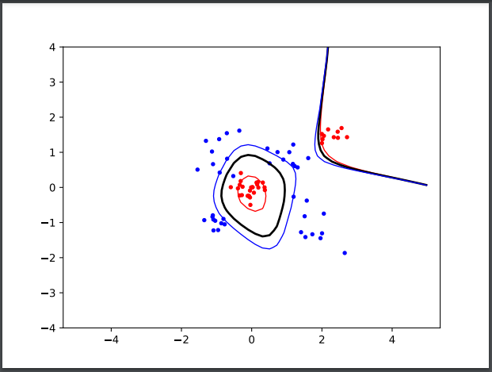
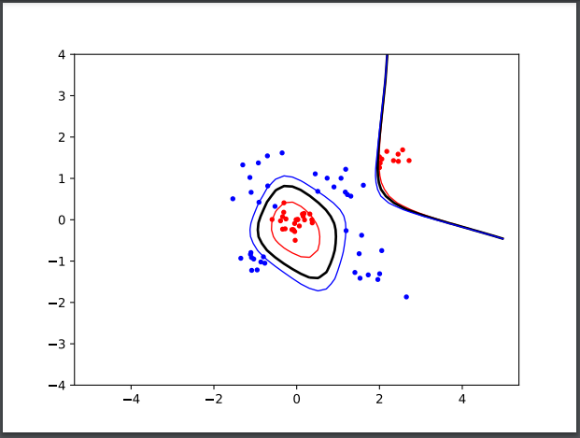
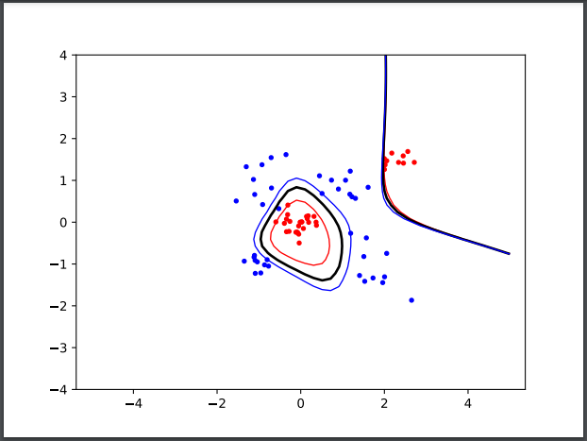
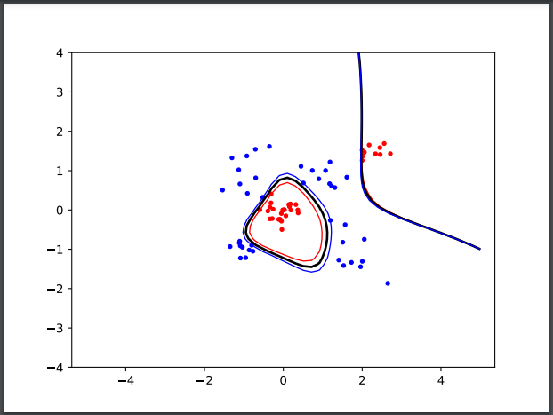
4. Role of slack parameter C

Slide 10
5. Slack vs Complex Kernel
Trade off between fitting the data exactly, or fitting the data “good enough”
When the data is not exactly linearly separable with line or hyperplane but almost with low error.
Choose the slack variable so that this error is minimized
Complex Kernels allow for “better” hyperplanes or lines
A more complex kernel can model the separation better.
However, this is more computer and data intensive.
Ex: The higher degree of polynomial, the more computing needs to be performed as the dimensions increase. Need to compute for every dimension.

